Slide 1
Windows File System – Nov 29 (ICS3C0)
Agenda
Mod A.5 Windows File System
Presentation / Debrief
Start Level 1 Today
Previous Work
Mod B.5 Python File Access
Mod A.4 Binary Numbers (DUE)
Case C.5 SIM Swap Fraud (DUE)
Mod A.3 OS Concept Map (DUE)
Upcoming
Tomorrow: Mod A.5 – Level 2

Slide 2
3D TicTacToe Integration – Nov 29 (ICS4C0)
Agenda
TicTacToe Project – Coding
Debug Code
Package & Deliver Code
TicTacToe Project – Design Lifecycle
Document Testcases
Upcoming
Past Due: SIM Swap Fraud Case Study

Slide 3
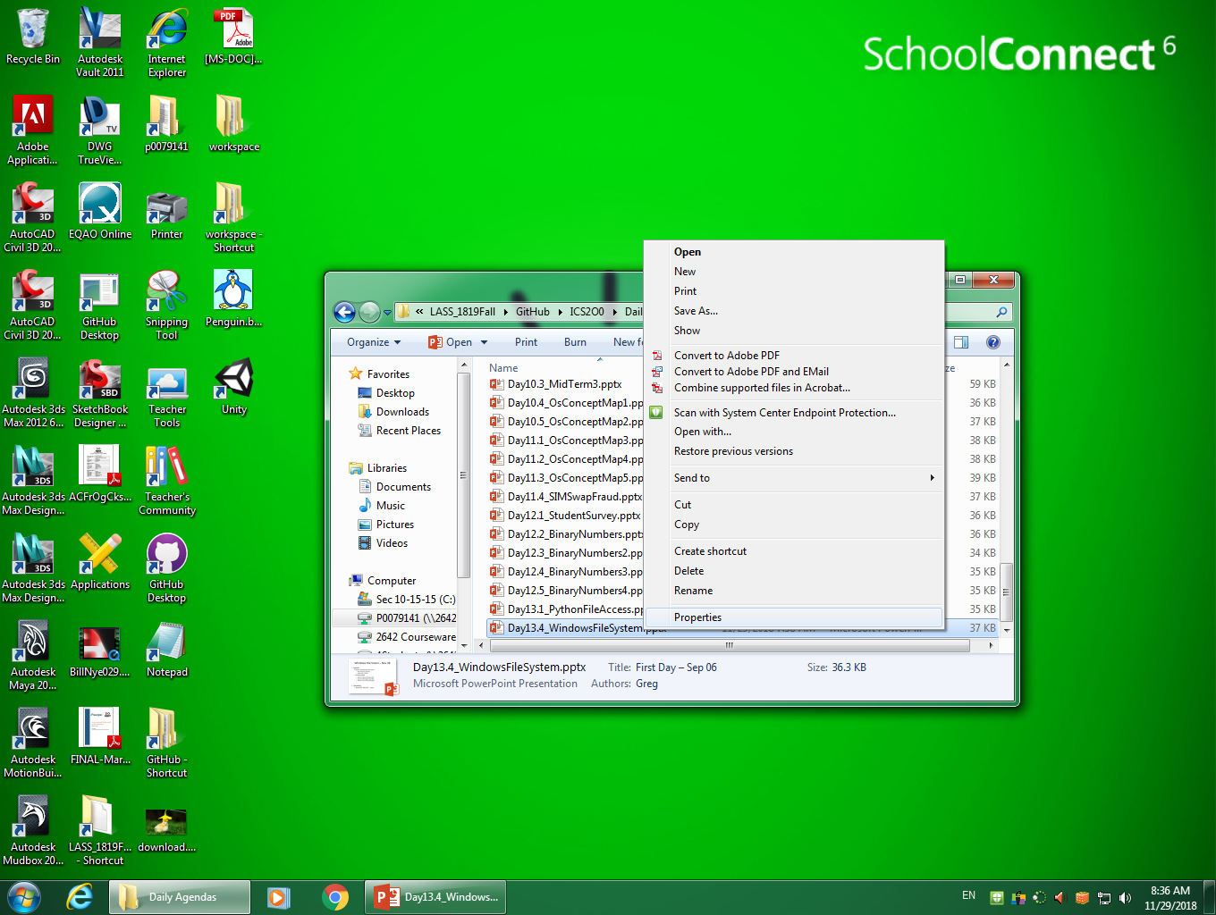

Slide 4
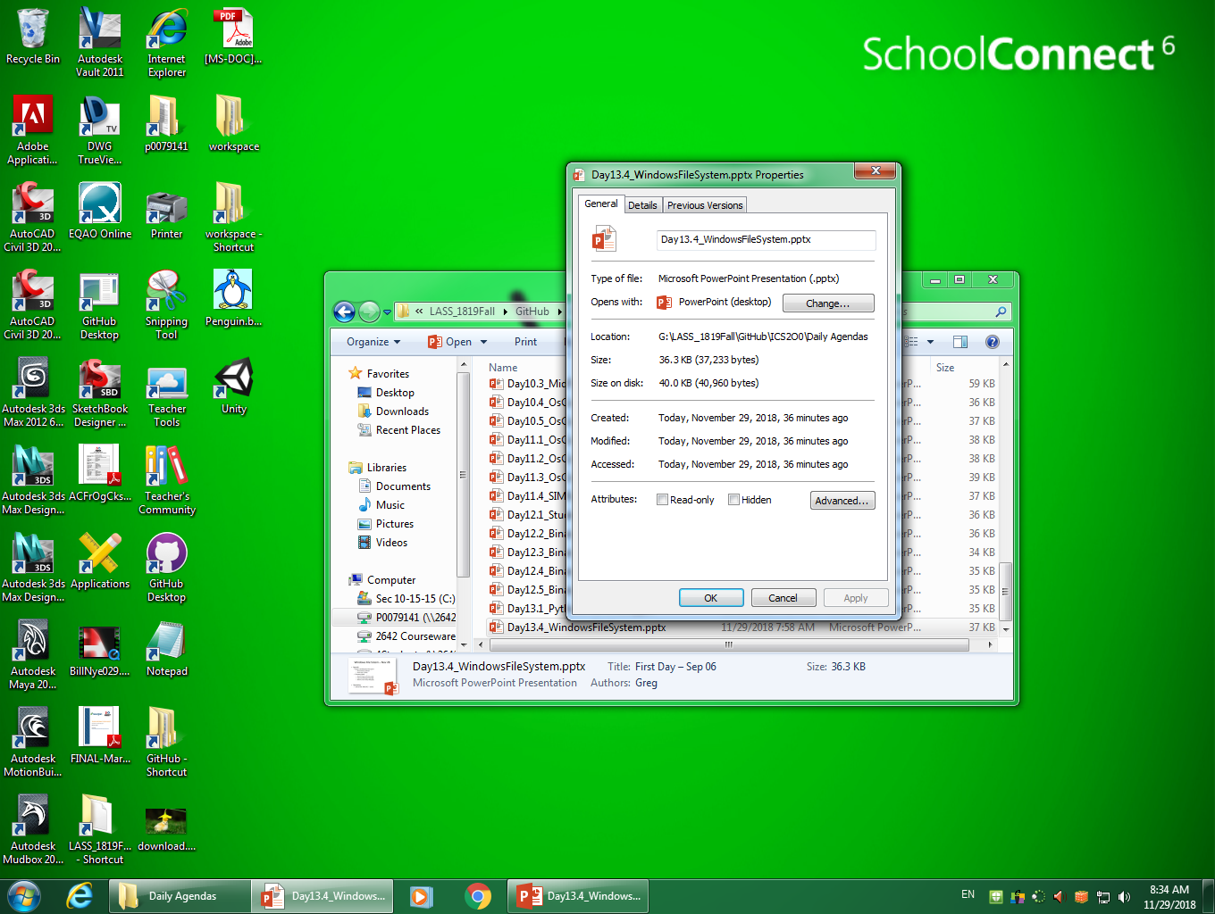

Slide 5
